Slide 1

7th Grade Accelerated Math
Unit 2, Lesson 4 Approximating Irrational Numbers Volume 1, pg. 79

Slide 2


Benchmarks
MA.8.NSO.1.1
Extend previous understanding of rational numbers to define irrational numbers within the real number system. Locate an approximate value of a numerical expression involving irrational numbers on a number line.
MA.8.NSO.1.2
Plot, order, and compare rational and irrational numbers represented in various forms.
volume 1, pg. 79

Slide 3
Integrated Mathematical Thinking and Reasoning Standards
MA.K12.MTR.3.1 Complete tasks with mathematical fluency.
MA.K12.MTR.4.1 Engage in discussions that reflect on the mathematical thinking of self and others.
MA.K12.MTR.5.1 Use patterns and structure to help understand and connect mathematical concepts.
volume 1, pg. 79

Slide 4

Learning Targets
I can identify whether a number is rational or irrational.
I can approximate the values of irrational numbers.
I can plot irrational numbers on a number line.
volume 1, pg. 79

Slide 5

Warm-Up
volume 1, pg. 80

Slide 6
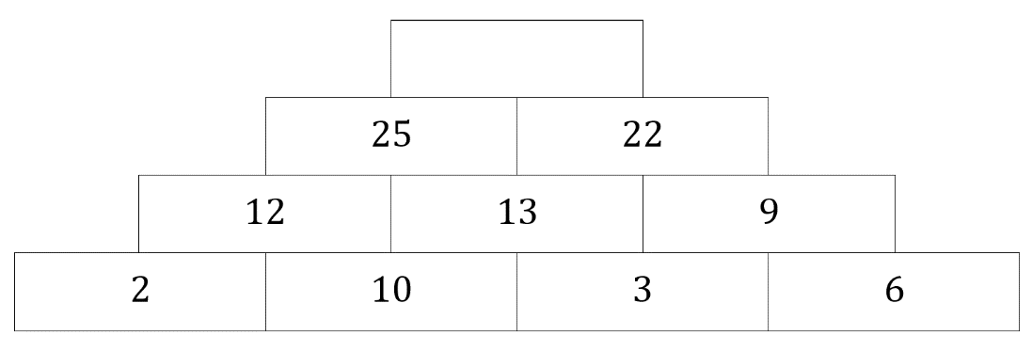
2.4.1 Warm-Up: Number Pattern
A pattern is shown with one value missing.
Determine the value of the empty cell in the pattern.
Explain how you determined the missing value.
volume 1, pg. 80

Slide 7

Collaboration
volume 1, pg. 80

Slide 8

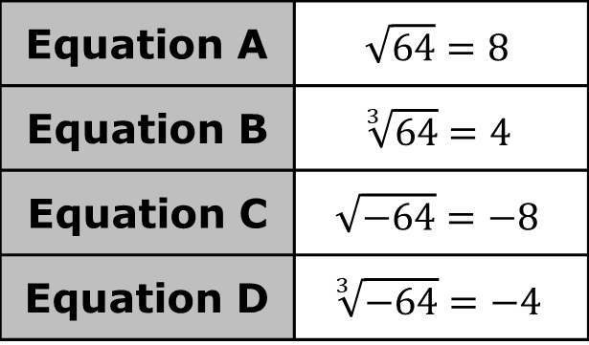
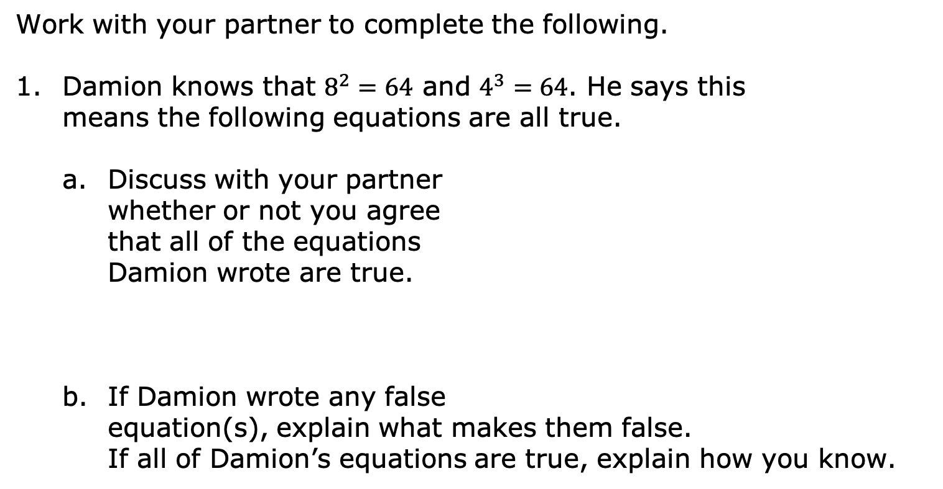
2.4.2 Collaboration: Square Roots vs. Cube Roots
Work with your partner to complete the following.
Damion knows that $8^{2}=64$ and $4^{3}=64$. He says this means the following equations are all true.
Discuss with your partner whether or not you agree that all of the equations Damion wrote are true.
If Damion wrote any false equation(s), explain what makes them false.
If all of Damion’s equations are true, explain how you know.
Equation A | $$\sqrt{64}=8$$
Equation B | $$\sqrt[3]{64}=4$$
Equation C | $$\sqrt{−64}=−8$$
Equation D | $$\sqrt[3]{−64}=−4$$
volume 1, pg. 80

Slide 9
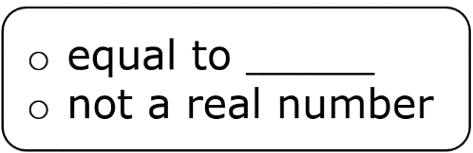
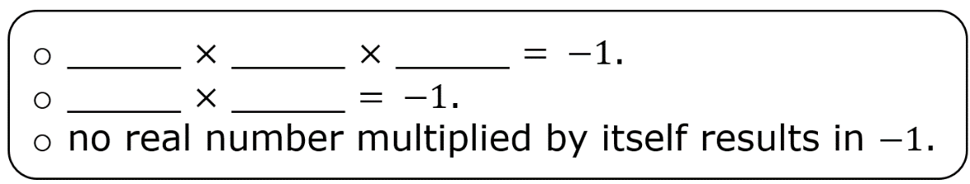

Complete each statement.
$\sqrt[3]{−1}$ is because
$\sqrt{−1}$ is because
volume 1, pg. 81

Slide 10

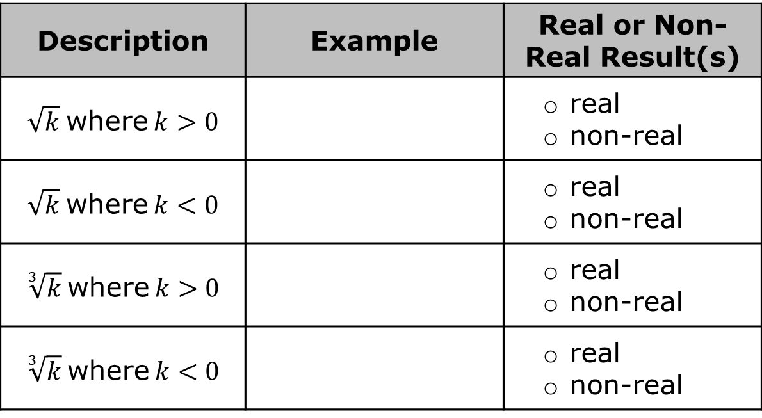
Work with your partner to complete the table by choosing a value of $k$ based on the inequality. Then, determine if the result is real or non-real.
Write a short explanation of when a non-real result will occur.
Description | Example | Real or Non-Real Result(s)
$\sqrt{k}$ where $k>0$ |  | real non-real
$\sqrt{k}$ where $k<0$ |  | real non-real
$\sqrt[3]{k}$ where $k>0$ |  | real non-real
$\sqrt[3]{k}$ where $k<0$ |  | real non-real
volume 1, pg. 81

Slide 11

Guided Instruction
volume 1, pg. 82

Slide 12



2.4.3 Guided Instruction: Rational and Irrational Numbers
The real number system includes both rational and irrational numbers.
Rational numbers can be written as a fraction, $\frac{a}{b}$, where $a$ and $b$ are integers and $b≠0$, or as a decimal. In decimal form, rational numbers either terminate or repeat.
When expressed as decimals, irrational numbers do not terminate or repeat. Therefore, any decimal expansion is only an approximate value.
A rational number is a real number that can be expressed as a ratio of two integers.
An irrational number is a real number that cannot be expressed as a ratio of two integers.
volume 1, pg. 82

Slide 13
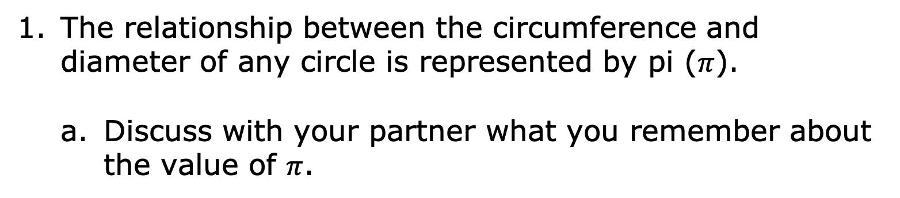
The relationship between the circumference and diameter of any circle is represented by pi ($π$).
Discuss with your partner what you remember about the value of $π$.
volume 1, pg. 82

Slide 14
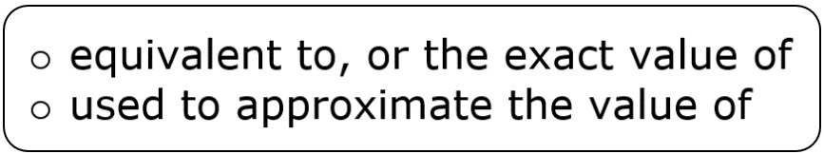
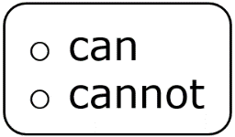

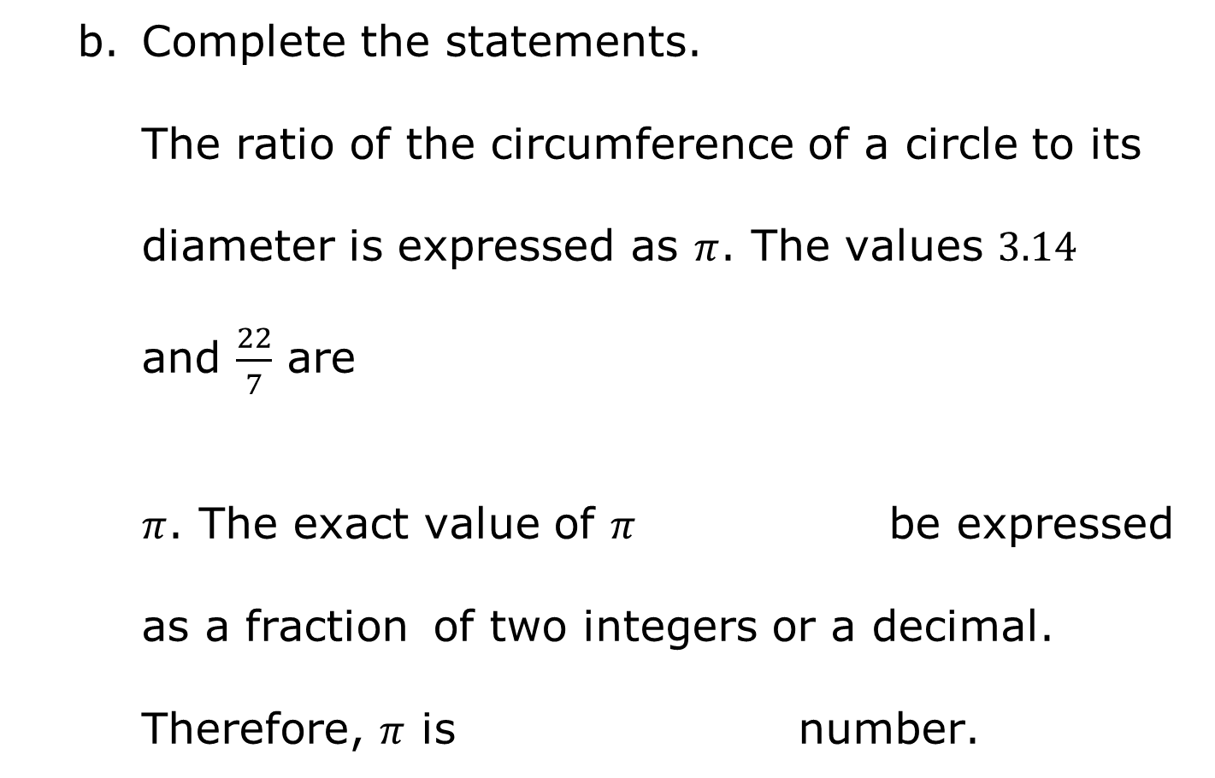
Complete the statements.
The ratio of the circumference of a circle to its
diameter is expressed as $π$. The values $3.14$ and $\frac{22}{7}$ are $π$. The exact value of $π$ be expressed as a fraction of two integers or a decimal. Therefore, $π$ is number.
volume 1, pg. 82

Slide 15
Enter each of the following values into a calculator.
Circle the values that can be expressed as a ratio of two integers.
Discuss with your partner how you would describe the values that are not circled.
$$\sqrt{25}$$ | $$\sqrt{18}$$ | $$\sqrt[3]{27}$$ | $$\sqrt[3]{30}$$
volume 1, pg. 83

Slide 16
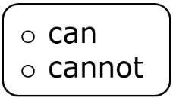
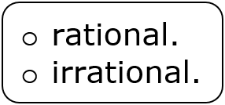
Complete the statements.
Square roots of perfect squares and cube
roots of perfect cubes be expressed
as a ratio of two integers. Therefore, they are
Square roots of non-perfect squares
and cube roots of non-perfect cubes
be expressed as a ratio of two integers. Therefore,
they are
volume 1, pg. 83

Slide 17

Exploration
volume 1, pg. 83

Slide 18

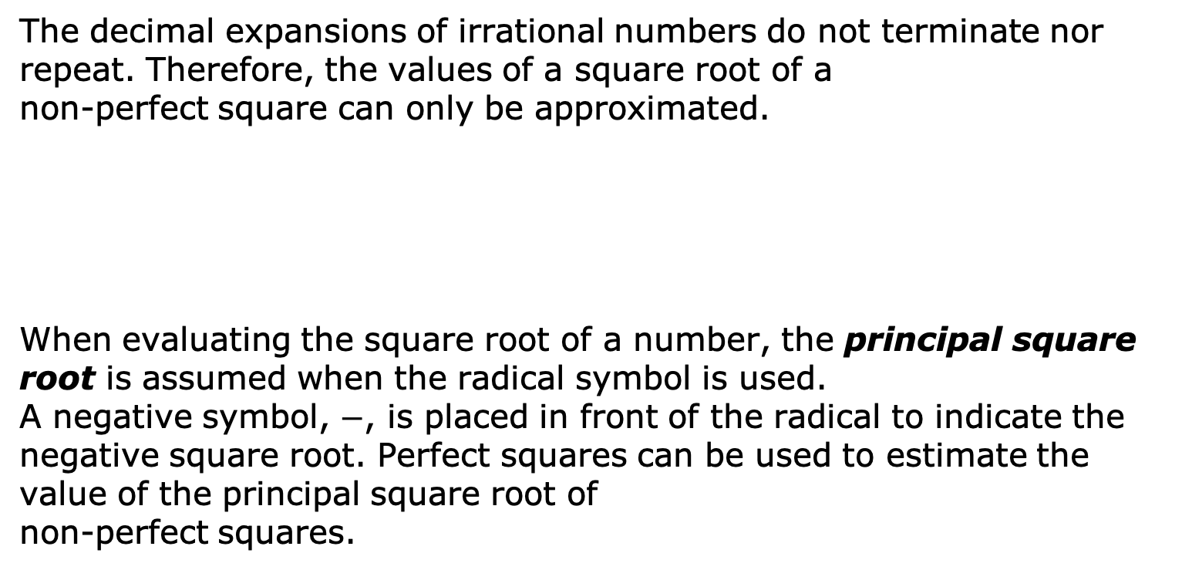
2.4.4 Exploration: Roots of Non-Perfect Squares and Non-Perfect Cubes
The decimal expansions of irrational numbers do not terminate nor repeat. Therefore, the values of a square root of a non-perfect square can only be approximated.
When evaluating the square root of a number, the principal square root is assumed when the radical symbol is used. A negative symbol, $−$, is placed in front of the radical to indicate the negative square root. Perfect squares can be used to estimate the value of the principal square root of non-perfect squares.
The principal square root is the positive square root of a positive real number.
volume 1, pg. 83

Slide 19
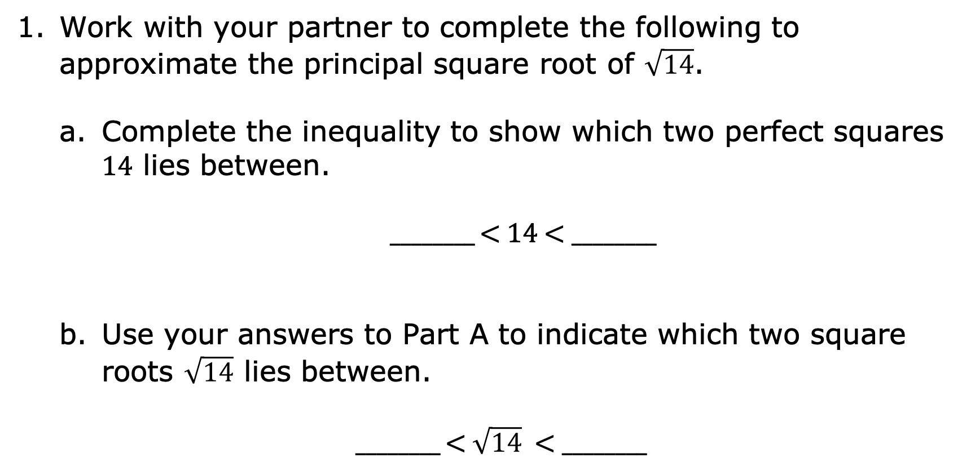
Work with your partner to complete the following to approximate the principal square root of $\sqrt{14}$.
Complete the inequality to show which two perfect squares $14$ lies between.
________ < $14$ < ________
Use your answers to Part A to indicate which two square roots $\sqrt{14}$ lies between.
________ < $\sqrt{14}$ < ________
volume 1, pg. 83

Slide 20
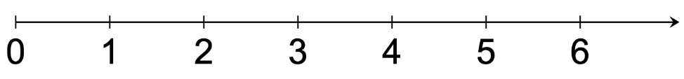

Discuss with your partner which square root the value of $\sqrt{14}$ is closer to.
Plot $\sqrt{14}$ on the number line to indicate its approximate value based on your discussion.
volume 1, pg. 83

Slide 21

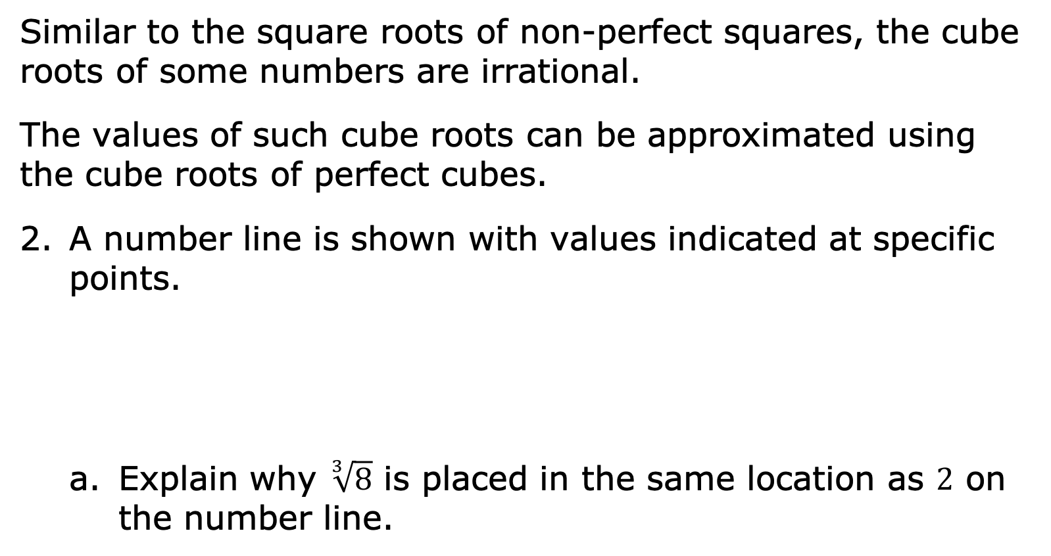


Similar to the square roots of non-perfect squares, the cube roots of some numbers are irrational.
The values of such cube roots can be approximated using the cube roots of perfect cubes.
A number line is shown with values indicated at specific points.
Explain why $\sqrt[3]{8}$ is placed in the same location as $2$ on the number line.
$$\sqrt[3]{8}$$
$$\sqrt[3]{27}$$
$$\sqrt[3]{64}$$
volume 1, pg. 84

Slide 22
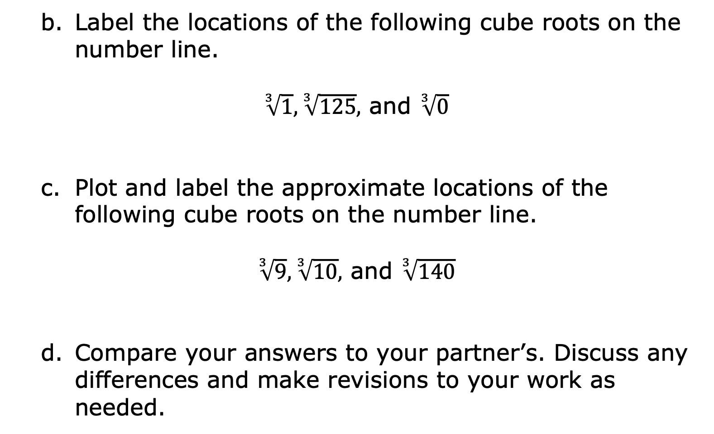
Label the locations of the following cube roots on the number line.
$\sqrt[3]{1}, \sqrt[3]{125},$ and $\sqrt[3]{0}$
Plot and label the approximate locations of the following cube roots on the number line.
$\sqrt[3]{9}, \sqrt[3]{10},$ and $\sqrt[3]{140}$
Compare your answers to your partner’s. Discuss any differences and make revisions to your work as needed.
volume 1, pg. 84

Slide 23
Guided Instruction
volume 1, pg. 85

Slide 24
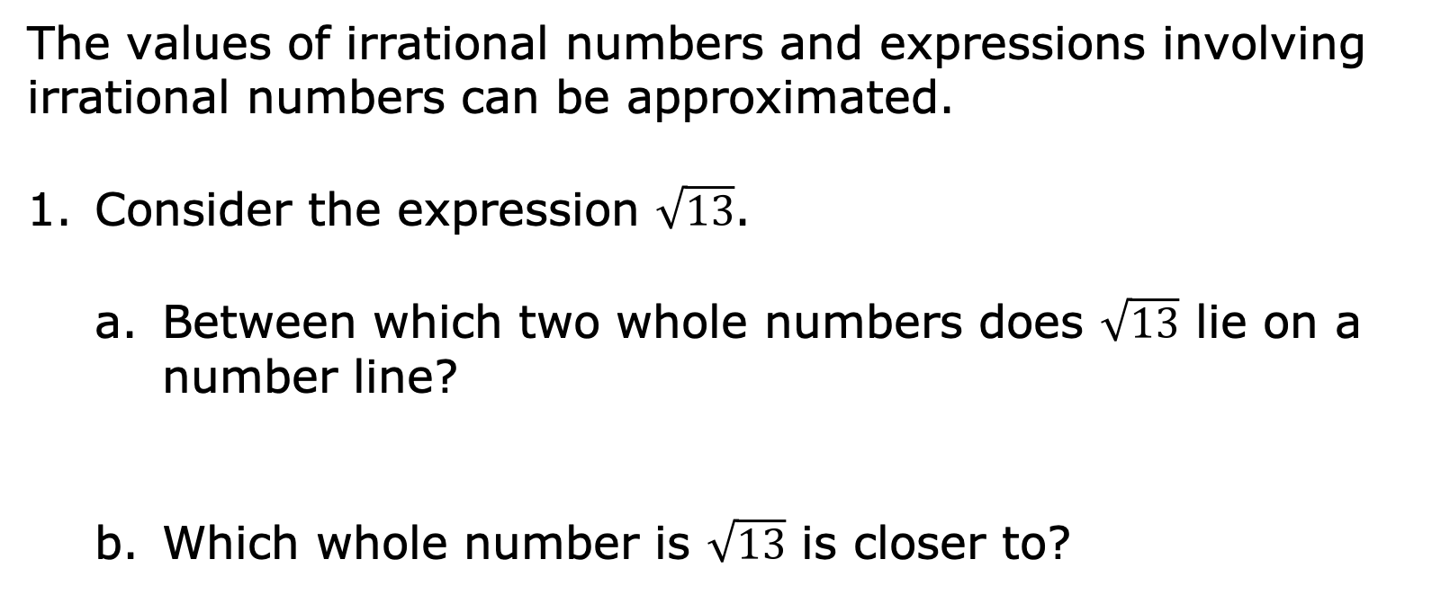
2.4.5 Guided Instruction: Approximating Irrational Numbers and Locating Them on a Number Line
The values of irrational numbers and expressions involving irrational numbers can be approximated.
Consider the expression $\sqrt{13}$.
Between which two whole numbers does $\sqrt{13}$ lie on a number line?
Which whole number is $\sqrt{13}$ is closer to?
volume 1, pg. 85

Slide 25
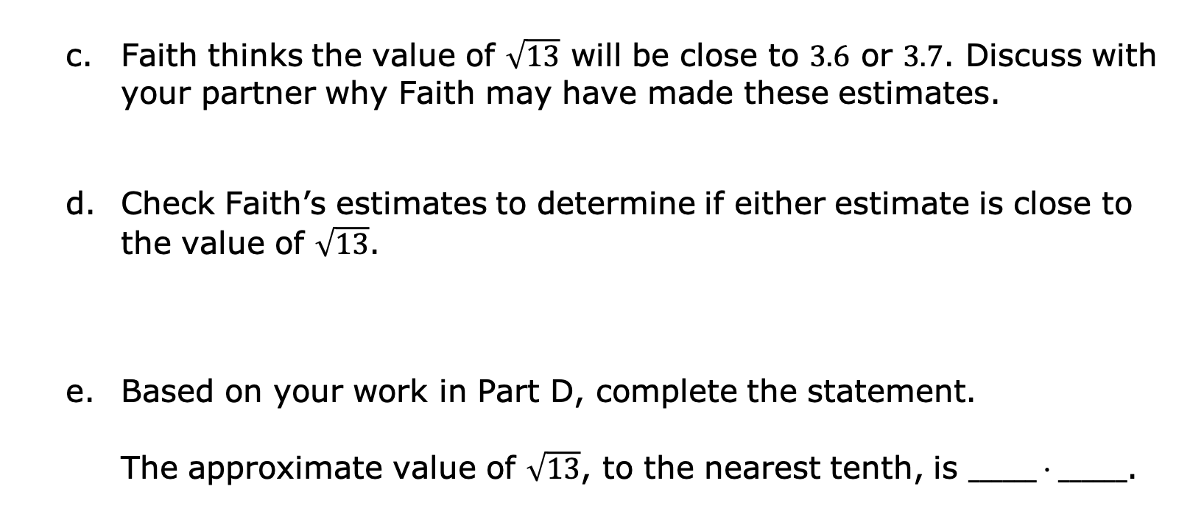
Faith thinks the value of $\sqrt{13}$ will be close to $3.6$ or $3.7$. Discuss with your partner why Faith may have made these estimates.
Check Faith’s estimates to determine if either estimate is close to the value of $\sqrt{13}$.
Based on your work in Part D, complete the statement.
The approximate value of $\sqrt{13}$, to the nearest tenth, is $______⋅______$.
volume 1, pg. 85

Slide 26
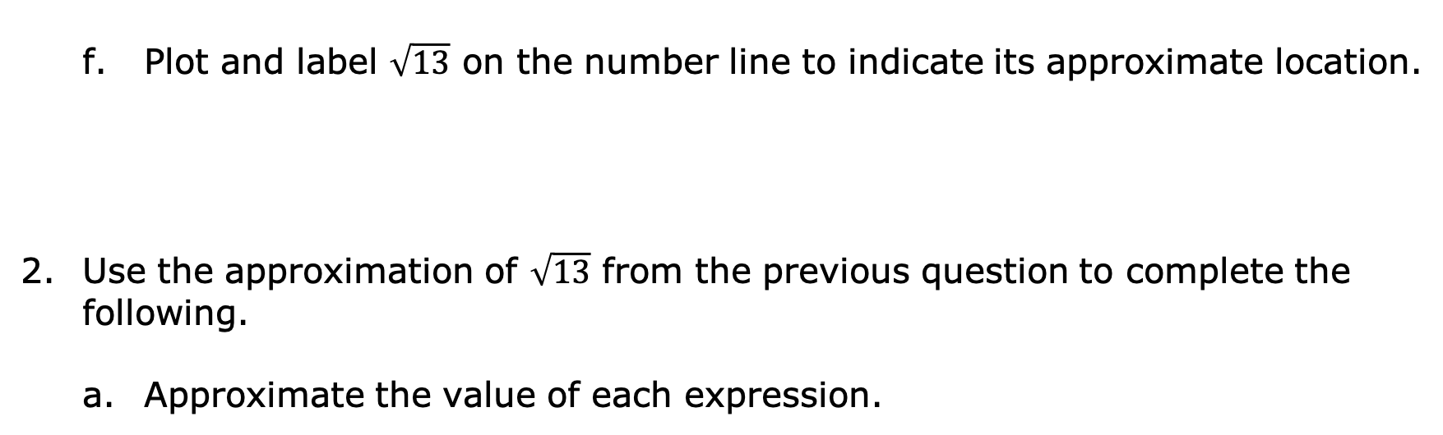
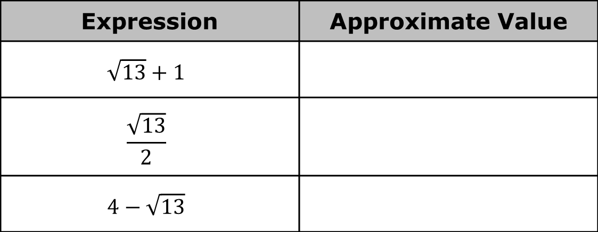
Plot and label $\sqrt{13}$ on the number line to indicate its approximate location.
Use the approximation of $\sqrt{13}$ from the previous question to complete the following.
Approximate the value of each expression.
Expression | Approximate Value
$$\sqrt{13}+1$$
$$\frac{\sqrt{13}}{2}$$
$$4−\sqrt{13}$$
volume 1, pg. 85

Slide 27
Plot and label the approximate location of each expression from part a on the number line.
To approximate the value of expressions involving irrational numbers, first approximate the value of the irrational number. Then, use that approximation to perform any operations indicated.
volume 1, pg. 85

Slide 28

Guided Practice
volume 1, pg. 86

Slide 29

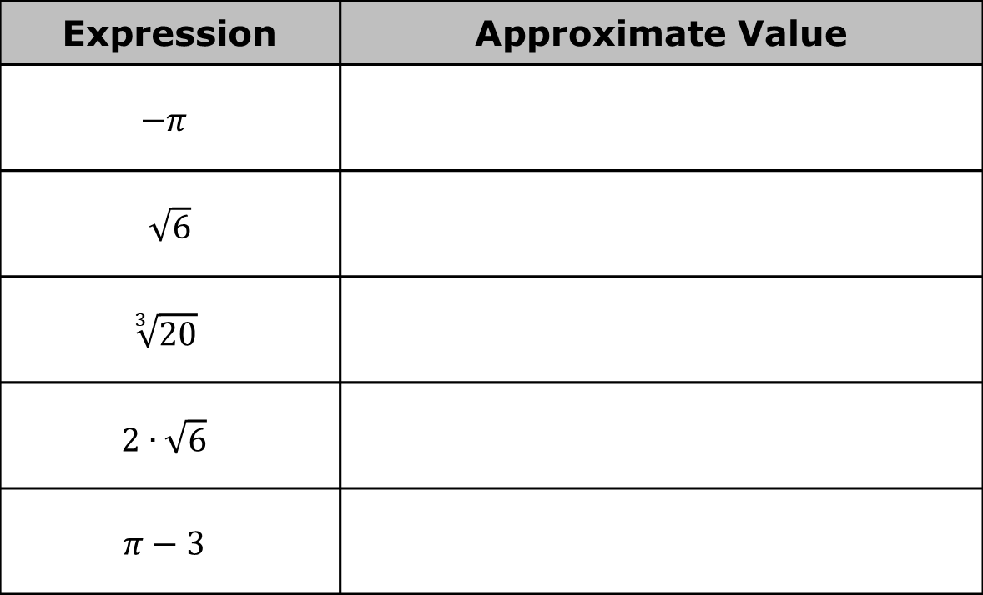
2.4.6 Guided Practice: Approximating Irrational Numbers and Locating Them on a Number Line
Approximate the value of each expression.
Expression | Approximate Value
$$−π$$
$\sqrt{6}$
$$\sqrt[3]{20}$$
$$2∙\sqrt{6}$$
$$π−3$$
volume 1, pg. 86

Slide 30
Plot and label the approximate location of each expression from the previous question on the number line.
volume 1, pg. 86

Slide 31

Wrap-Up
volume 1, pg. 86

Slide 32
2.4.7 Wrap-Up: Cool Down
Explain the process for approximating an irrational number. Include each step in your process.
volume 1, pg. 86

